Slide 1

CONSTELLATION CODERS
PRESENTS
STELLER ATLAS

Slide 2

Your All-in-One Community & Utility Hub for the Cosmos.
By - Anvay Ghare and Arnav Karandikar

Slide 3


THE PROBLEM:
A FRAGMENTED UNIVERSE
TODAY'S SPACE ENTHUSIAST IS FORCED TO USE A DOZEN SCATTERED TOOLS. THE JOURNEY FROM CURIOSITY TO HOBBY IS BROKEN.
1.
WHERE DO I LOOK FOR RESOURCES?
2.
WHAT ARE THE CURRENT UPDATES?
3.
WHO DO I ASK AND BELIEVE?
4.
HOW DO I START STARGAZING
5.
HOW DO I CONNECT WITH THE SPACE COMMUNITY
WE OBSERVED THAT THERE IS NO SINGLE ECOSYSTEM TO GUIDE A USER'S JOURNEY. THIS FRAGMENTATION KILLS CURIOSITY

Slide 4

THE SOLUTION:
A UNIFIED 360° ECOSYSTEM
Pillar 1.
Pillar 2.
Pillar 3.
LEARN HUB
INTERACT
DISCOVER
We combined a resource library with powerful utilities, like a Stargazing Forecast and an AI-powered search, sun locater, “how to stargaze” guide all in one 'Learn' hub.
A built-in social hub to discuss news, share astrophotography in our gallery, and take community polls. This is what will make our users return.
A dynamic feed of the latest news and an interactive encyclopedia of every major space mission—past, present, and future.

Slide 5


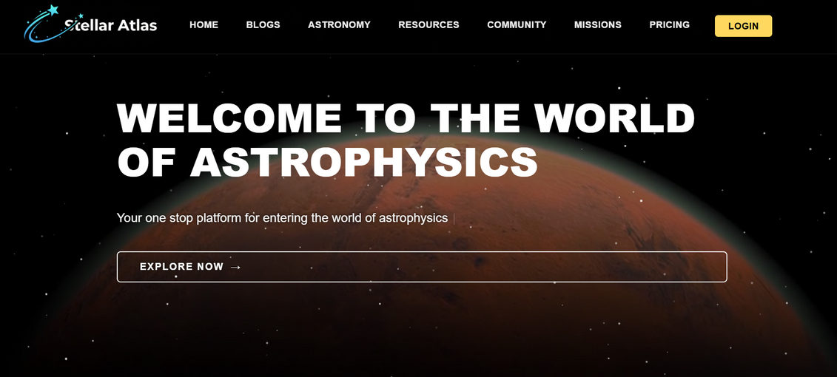
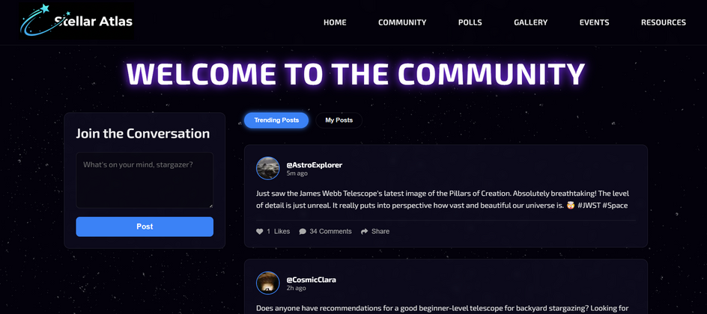
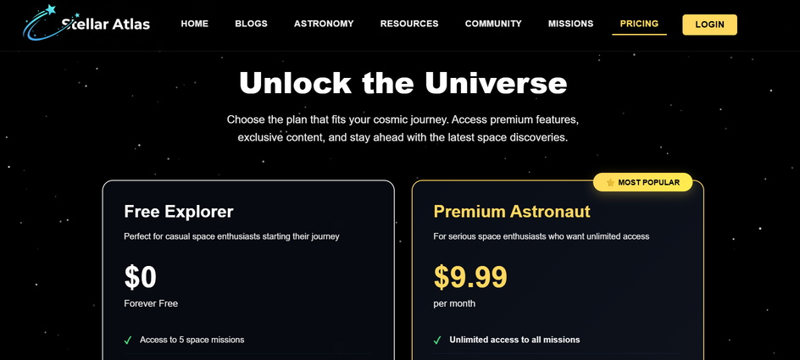
THE VALUE LOOP: FROM UTILITY TO COMMUNITY
PRIMARY OBJECTIVE IS TO TURN PASSIVE LEARNING INTO ACTIVE, COMMUNITY-GENERATED CONTENT.

Slide 6



OUR VISION: FROM PROJECT TO PRODUCT
OUR BUSINESS MODEL
FREE TIER: FULL ACCESS TO THE COMMUNITY HUB & ALL STANDARD LEARNING TOOLS. THIS IS OUR GROWTH ENGINE.
PRO TIER: UNLOCKS THE CUSTOMIZABLE "MISSION CONTROL" DASHBOARD—A PERSONAL HUB WITH "MY FORECAST," "MY TRACKED MISSIONS," AND EXCLUSIVE "LEARNING QUESTS."
WE WANT OUR PRODUCT TO BE THE ECOSYSTEM THAT GUIDES A USER FROM A SPARK OF CURIOSITY TO A LIFELONG HOBBY.

Slide 7


Thank You!

